Slide 1

Part1 Introduction to operating systems
1.4 The main functions of the operating system
1.5 OS structure design

Slide 2
1.4 The main functions of the operating system
The main purpose of introducing OS is to provide a good operating environment for the operation of multi-channel programs(multiprograming), so as to ensure the orderly and efficient operation of multi-channel programs, and to maximize the utilization of various resources in the system for the convenience of users. Therefore, the traditional OS should have such basic functions as processor management, memory management, equipment management and file management. In addition, to facilitate the use of the OS, users need to be provided with a convenient user interface.

Slide 3
1.4.1 Processor management function
1.Process control
For jobs to execute concurrently in a multiprogramming environment, one or more processes must be created for each job and the necessary resources allocated to them. The main functions of process control are to create a process for a job, cancel (terminated) a process, and control the state transitions of a process while it is running.
2. Process synchronization
In order to make multiple processes run orderly, the system must set up the corresponding process synchronization mechanism. the main task of this mechanism is to coordinate the operation of multiple processes (including threads).

Slide 4
1.4.1 Processor management function
3. Process communication
When there is a cooperative set of processes to accomplish a common task, there is often an exchange of information between them.The task of process communication is to exchange information between mutually cooperating processes.
4. Scheduling
(1) job scheduling.
(2) process scheduling.

Slide 5
1.4.2 Memory management function
1.Memory allocation the main task of memory allocation is to:
(1) allocate memory space for each program .
(2) improve the utilization of memory and minimize the memory space (fragmentation) that is not available.
(3) allow running programs to request additional memory space to accommodate the dynamic growth of programs and data.

Slide 6
When OS realizes memory allocation, it can take two ways: static and dynamic :
(1) static allocation. The memory space of each job is determined when the job is loaded, and the job is not allowed to apply for new memory space during the entire run after the job is loaded, nor is the job allowed to "move" in memory.
(2) dynamic allocation. The base memory space required for each job, while also determined at load time, allows the job to continue to request new additional memory space during run time to accommodate the dynamic growth of programs and data, and also allows the job to "move" in memory.

Slide 7
2.Memory protection the main task of memory protection is:
(1) to ensure that each user program is only in their own memory space to run, each non-interference.
(2) never allow the user program access to the operating system's program and data, also do not allow the user program to move to other user programs that are not Shared to execute.

Slide 8
3. Address mapping
In a multiprogramming environment, because each program after compile and link can be formed by the loader its address begins with 0, but they could not begin from "zero" address (physical) into memory, each segment address space within the logical address and physical address in the memory space is not consistent. In order to ensure that the program can run correctly, memory management must provide address mapping, that is, the ability to translate the logical address in the address space to the corresponding physical address in the memory space. This function should be done with the support of hardware.

Slide 9
4. Memory expansion
Memory expansion is not from the physical up to expand the memory capacity, but with the help of virtual storage technology, from the logical expansion of memory capacity, the user felt memory capacity is much larger than the actual memory capacity, so that more user programs can run concurrently. This not only meets the needs of users, but also improves the performance of the system. In order to logically expand memory, the system must set up a memory expansion mechanism (with a small amount of hardware) to implement the following functions :
(1) request the call in function.
(2) displacement function.

Slide 10
1.4.3 Equipment management function
The main tasks of device management are as follows :
(1) complete the I/O requests made by the user process, assign the required I/O devices to the user process, and complete the specified I/O operations.
(2) improve the utilization rate of CPU and I/O devices, improve the speed of I/O, and facilitate users to use I/O devices.
In order to achieve the above tasks, the equipment management should have the functions of buffer management, equipment allocation and equipment processing, and virtual equipment.
1. Buffer management
2. Equipment allocation
3. Equipment handling

Slide 11
1.4.4 File management function
1. File storage space management
2. Directory management
3. File read/write management and protection
(1) file read/write management.
(2) file protection.

Slide 12
1.4.5 The interface between the operating system and the user
1. User interface
(1) online user interface.
(2) offline user interface.
(3) graphical user interface.

Slide 13
2. Program interface
The program interface is the only way for the user program to obtain the operating system service. It consists of a set of system calls, each of which is a subroutine that performs a specific function. Whenever an application requires the OS to provide a service (function), a system call (subroutine) with the corresponding function is invoked. Early system calls were provided in assembly language and could only be used directly in programs written in assembly language.

Slide 14
1.4.6 New features of modern operating systems
Modern operating system is developed on the basis of traditional operating system. It not only has the functions of traditional operating system, but also adds the functions of security, network and multimedia.
1. System safety
(1) certification technology.
(2) cryptography.
(3) access control technology.
(4) anti-virus technology.

Slide 15
2. Network functions and services
(1) network communication.
(2) resource management.
(3) application interoperability.

Slide 16
3. Support multimedia
(1) accept the control function.
(2) real-time scheduling.
(3) storage of multimedia files.

Slide 17
1.5 OS structure design
Early OS sizes were small, as small as a few dozen kilobytes, and could have been written by a single person by hand in a matter of months. At this point, programming is basically a skill, whether the OS is structured is not so important, it is the programmer's programming skills. However, with the increasing scale of OS, it has more and more code, often need to be dozens or hundreds of people or even more people to participate in the division of labor to complete the design of the operating system. This means that engineering development methods should be used to develop large software. From this came "software engineering".

Slide 18
1.5.1 Traditional operating system architecture
1. Unstructured operating system
In the early days of operating system development, the designer only focused his attention on the realization of functions and to achieve high efficiency, the lack of consistent design ideas. The OS at this time is a collection of numerous sets of procedures, each of which can arbitrarily call other procedures, resulting in both complexity and chaos within the operating system. Therefore, the OS is unstructured, and some people call it the overall system structure.

Slide 19
2. Modular structure OS
1) basic concept of modular programming technology
Modular programming technology is a structured programming technology that emerged in the 1960s. This technique is based on the principles of "decomposition" and "modularization" to control the complexity of large software. To give OS a clearer structure, OS is no longer made up of many processes directly, but is carefully divided into several independent and sized modules according to their functions. Figure 1-7 shows the modular OS structure composed of modules, sub-modules, etc.

Slide 20
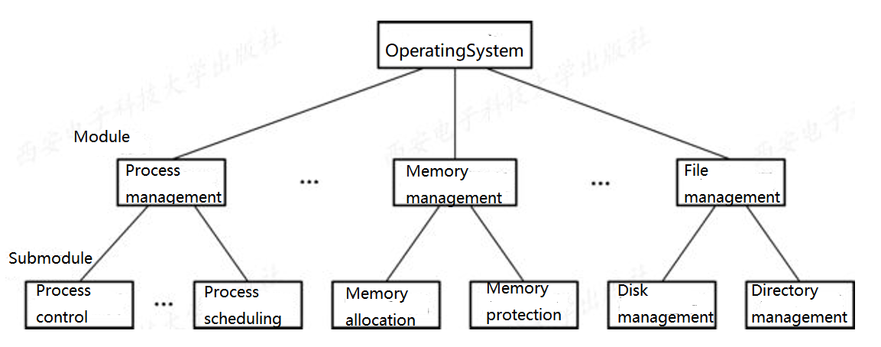
Figure1-7 Modular structured operating system

Slide 21
2) Module independence
In the module-interface method, the key problem is to divide the modules and specify the interface between the modules. If we divide the modules into too small, although the complexity of the modules can be reduced, it will lead to too many connections between the modules, which will cause the system to be confused. If the module is divided too large, it will increase the complexity of the module and increase the internal connection. Therefore, when dividing the module, it should make a balance between the two.

Slide 22
3) advantages and disadvantages of module-interface method
Compared with the unstructured OS, the OS developed by the mode-interface method has the following obvious advantages :
(1) improve the correctness, understandability and maintainability of OS design.
(2) enhance the adaptability of OS.
(3) accelerate the development process of OS.

Slide 23
The following problems still exist in the modular structure design :
(1) in the OS design, it is difficult to meet the actual requirements for the interface between modules after the completion of the module design.
(2) the OS design phase, the designer must make a series of decisions , every decision must be based on a decision on the basis of the modular structure design, module design go hand in hand, can't find a reliable decision order, cause all kinds of decision "disorder", this will make the program it's hard to do every step in the design of "decision" is built on the basis of reliable, so the module interface method is also known as "disorderly module method".

Slide 24
3. Hierarchical structure OS
1) Basic concept of hierarchical structure
In order to change the disorder of "decision order" in the module-interface method into order, the method of order layering is introduced. The design task of the layering method is to lay several layers of software A₁, A₂, A₃... A_{n-1},between the target system A_{n} and bare-machine system (also known as host system)A₀ , make A_{n} through A_{n-1}, A_{n-2}... , A₂, A₁ layer, finally can run on A₀. In operating systems, the bottom-up approach is often used to lay these intermediate layers.

Slide 25
2) Advantages and disadvantages of hierarchical structure
The main advantages of the layered structure are :
(1) easy to ensure the correctness of the system.
(2) easy to expand and easy to maintain.
The main drawback of the hierarchical structure is that the system is inefficient. Since the hierarchy is hierarchical and one-way dependent, the communication mechanism between layers must be established between each layer. For each function performed by the OS, it usually crosses multiple layers from top to bottom, which will undoubtedly increase the communication overhead of the system and lead to the reduction of system efficiency.

Slide 26
1.5.2 Client/Server Model
1. The origin, composition, and type of the client/server pattern
The client/server system consists of three main parts.
(1) client
(2) server
(3) network system

Slide 27
2. Client/server interaction
(1) the client sends the request message.
(2) the server receives the message.
(3) the server sends back the message.
(4) the client receives the message.

Slide 28
3. Advantages of the client/server model
(1) data distribution processing and storage.
(2) convenient for centralized management.
(3) flexibility and extensibility.
(4) easy to adapt the application software.

Slide 29
1.5.3 Object-Orientated Programming
1. Basic concepts of object-oriented technology
Object-oriented technology was proposed in the early 1980s and quickly became popular.

Slide 30
1) Object
In object-oriented technology, an object in a system is represented by a encapsulated data structure (a variable) and a set of procedures (methods) that manipulate it, as shown in figure 1-8. A variable (data) in an object is also called a property and can be a single scalar or a table. A method in object orientation is a procedure used to perform a function that changes the state of an object, updates some data value in the object, or ACTS on external resources that the object wants to access. If you treat a file as an object (see figure 1-9), the variables for that object are the file type, the file size, the creator of the file, and so on. The methods in the object contain actions on a file, such as creating a file, opening a file, reading a file, writing a file, closing a file, and so on.

Slide 31
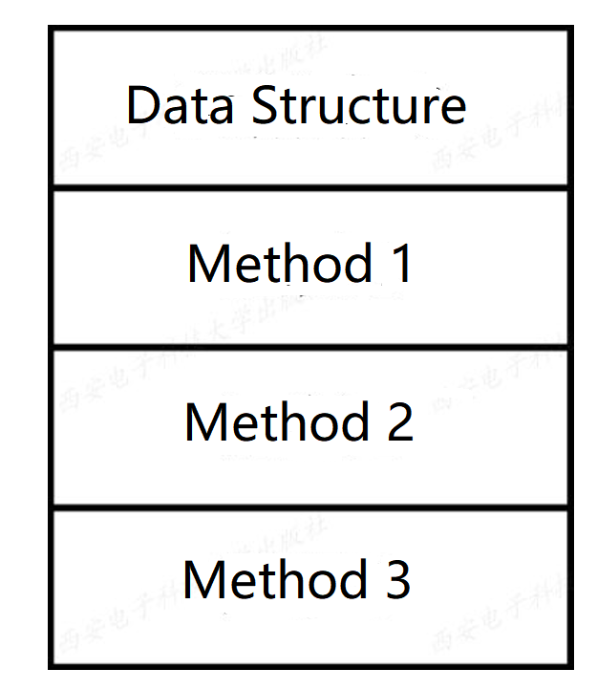
图1-8 A schematic of an object

Slide 32
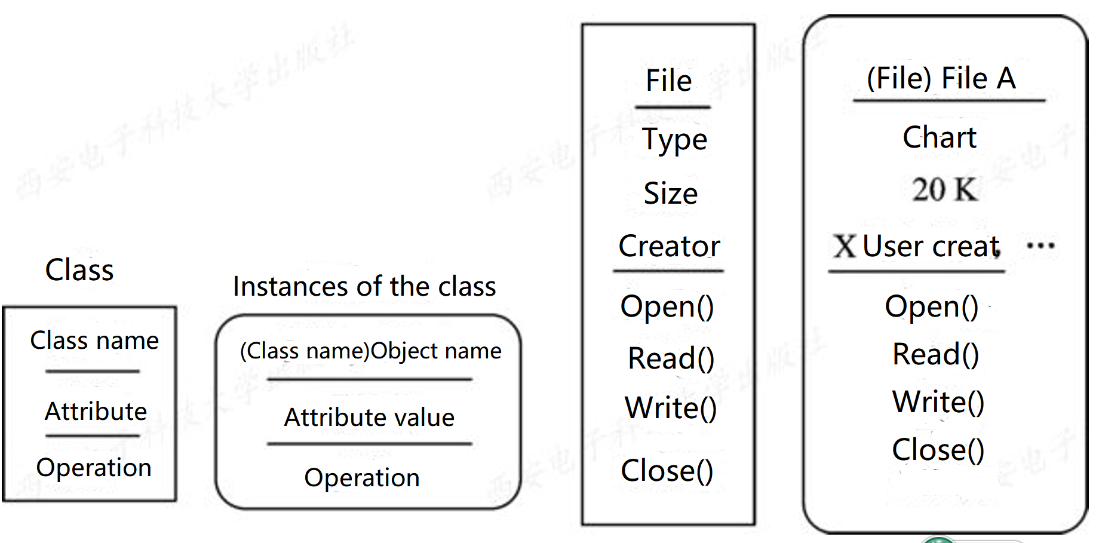
Figure1-9 The relationship between classes and objects

Slide 33
2) Object class
In practice, there are many objects that might represent the same class of things, each with its own set of variables that have the same methods. It is obviously inefficient to define a set of variables and methods for each similar object, hence the concept of "object classes", which are used to define a set of broadly similar objects. A class also defines a set of variables and a set of methods for that variable to describe the common properties and behavior of a set of objects. A class is an abstraction on an object, and an object is an instance of the class. Variables defined in an object class have specific values in the instance.

Slide 34
3) Inheritance
In object-oriented techniques, you can define A new class based on an existing class. The new class is called A subclass (B) and the original class is called A parent class (A), as shown in figure 1-10.

Slide 35
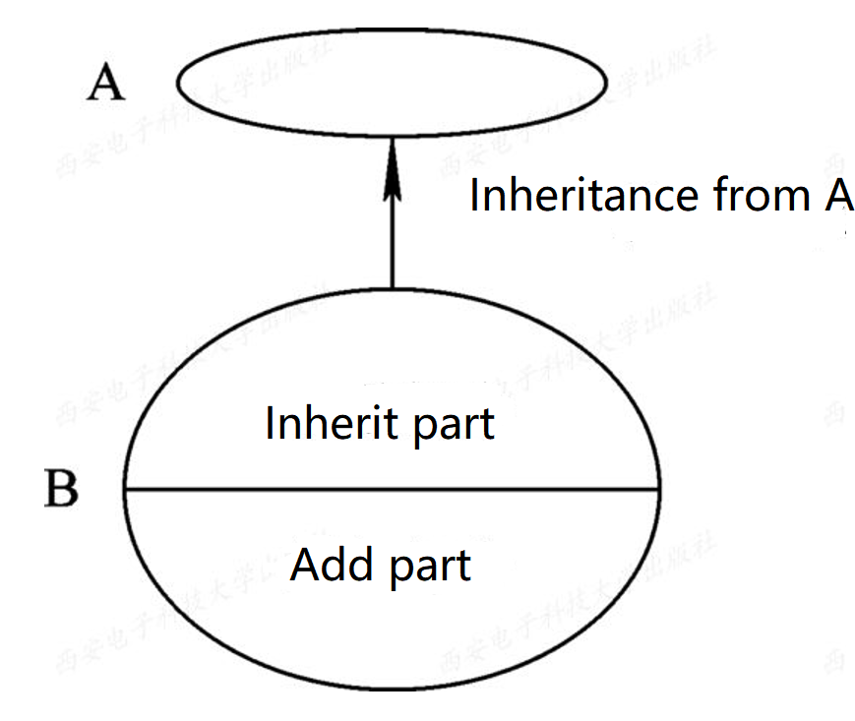
图1-10 The relationship of inheritance of class

Slide 36
2. The advantages of object-oriented technology
When designing an operating system, treating the entities in the computer as objects provides the following benefits :
(1) improving product quality and productivity through "reuse." (2) make the system easier to modify and expand.
(3) it is easier to guarantee the "correctness" and "reliability" of the system.

Slide 37
1.5.4 Microkernel OS structure
1. The basic concept of a microkernel operating system
1) A sufficiently small kernel
In the microkernel operating system, the kernel refers to the carefully designed, can achieve the most basic core functions of the modern OS small kernel, microkernel is not a complete OS, but only the most basic part of the operating system into the microkernel, usually contains: 1 with hardware processing closely related parts; Some more basic functions; Communication between the client and the server. The most basic part of these OS is simply to provide an important foundation for building a generic OS, so that you can ensure that the operating system kernel is kept small.

Slide 38
2) Based on the client/server pattern
Because the client/server model has a lot of advantages, so in stand-alone almost without exception, all in the microkernel operating system adopts client/server mode, will be the most basic part of the operating system into the kernel, and most of the functionality of the operating system on the microkernel outside of a set of server (process) in the implementation, such as to manage the process (thread) is used to provide the process (thread) server, provides the virtual memory management functions of virtual storage server, provide the I/O device management server I/O device management, etc., they are implemented as a process, running in user mode, The client and server interact with each other through the messaging mechanism provided by the microkernel. Figure 1-11 shows the client/server pattern in a stand-alone environment.

Slide 39
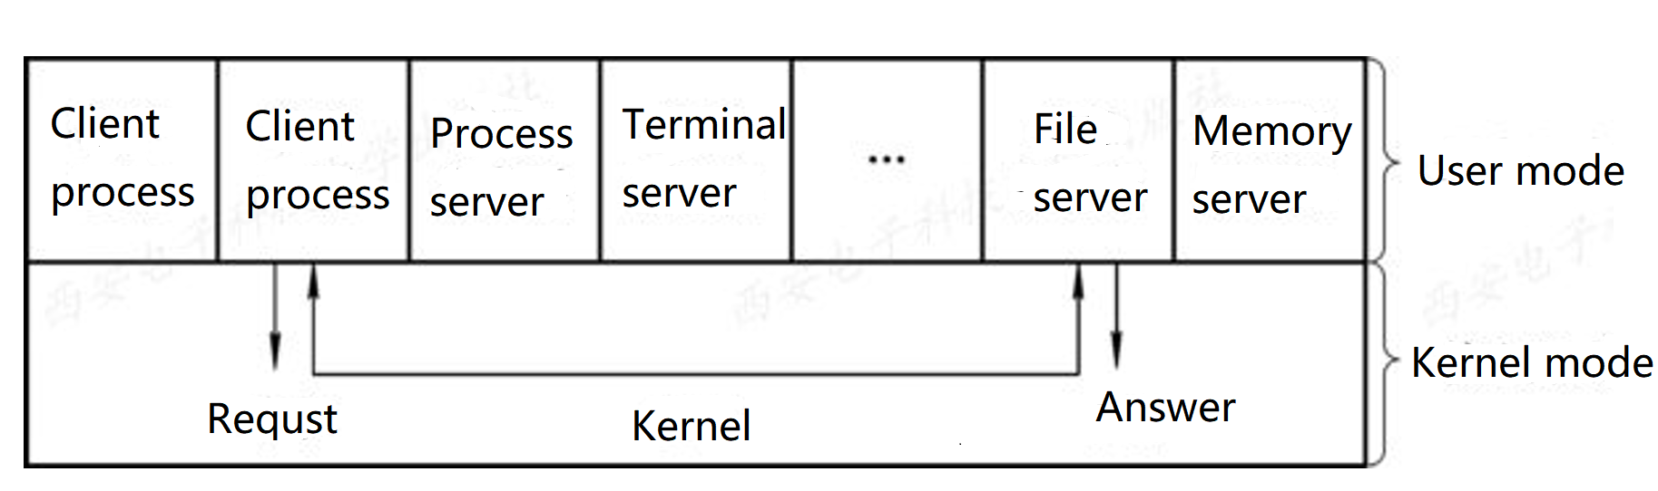
Figure 1-11 Client/server mode in a stand-alone environment

Slide 40
3) Apply the principle of "mechanism and policy separation"
In the current operating system structure design, the principle of "mechanism and policy separation" is often used to construct the OS structure. So - called mechanism, it is to point to the realization of a function of the specific executive. Strategy, on the basis of mechanism, is to achieve the optimization of the function by means of some parameters and algorithms, or to achieve different functional objectives.

Slide 41
4) Adopt object - oriented technology
Operating system is a very complicated large software system, we not only can be resolved through the structure design of the complexity of the operating system, can also be based on the object-oriented technology in the "abstract" and "hidden" the principle of the complexity of the control system, and further make use of the "object", "packaging" and "inheritance" to ensure that the "correctness" of the operating system, "reliability", "easy to modify", "easy extensibility, etc., and improve the design speed of the operating system. Because object-oriented technology can bring so many benefits, object-oriented technology is widely used in the design of modern operating systems.

Slide 42
2. Basic functions of the microkernel
There is no clear definition of what functions the microkernel should have, or what functions should be in and what should be outside the microkernel. It is now common to adopt the principle of "mechanism and policy separation", putting the mechanism part and the part closely related to the hardware into the micro kernel. From this we can see that the microkernel usually has the following functions:
1) process (thread) management
2) low-level memory management
3) interrupt and sink handling

Slide 43
3. Advantages of microkernel operating systems
Because the micro-kernel OS structure is built on the basis of modular, hierarchical structure, and the use of customer/server mode and object-oriented programming technology, so the micro-kernel OS structure is a collection of various technical advantages of the operating system, so it has the following advantages :
(1) improve the scalability of the system.
(2) enhanced the reliability of the system.
(3) strong portability.
(4) provide support for distributed systems.
(5) integrated object-oriented technology。

Slide 44
Review
excercise:
There are three program A,B,C, they use a same I/O device to operate, and in the order of priority of A,B and C. The count and I/O operation times of three programs are shown in table 1-1. If the scheduled time is negligible, draw a graph of the elapsed time in a Simple batch system and a multiprogramming system (assuming all three programs can be loaded in memory) and compare their total elapsed time.

Slide 45
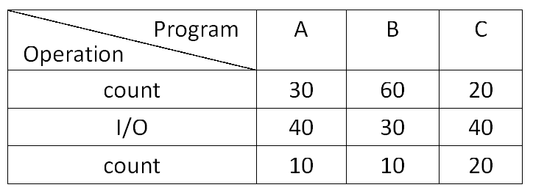

Slide 46
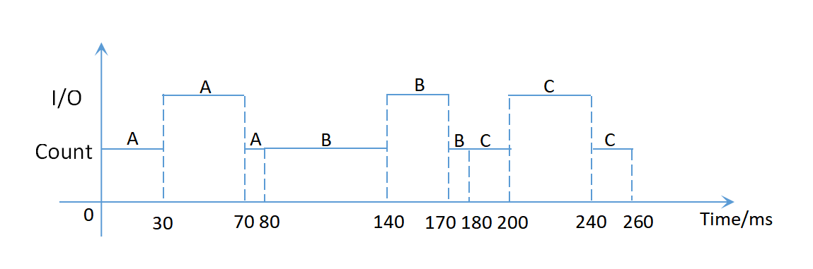
Figure 1 Elapsed time in Simple batch system

Slide 47
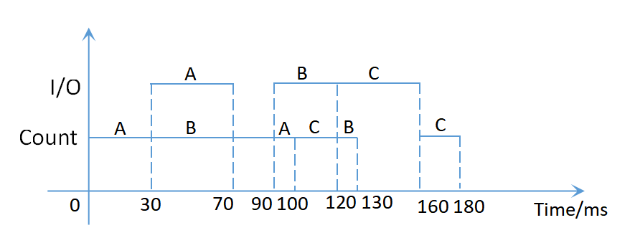
Figure 2 Elapsed time in multiprogramming system (nonpreemptive)

Slide 48
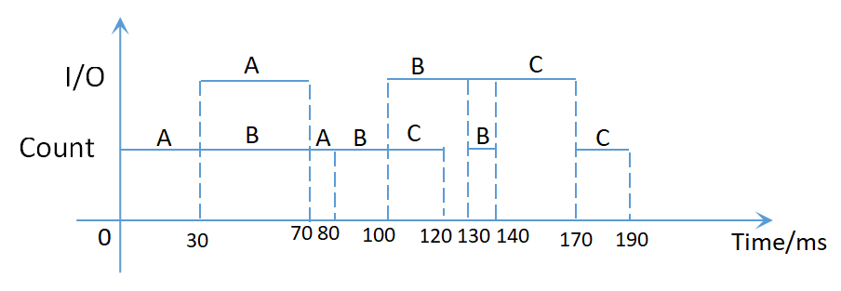
Figure 3 Elapsed time in multiprogramming system (preemptive)

